Slide 1
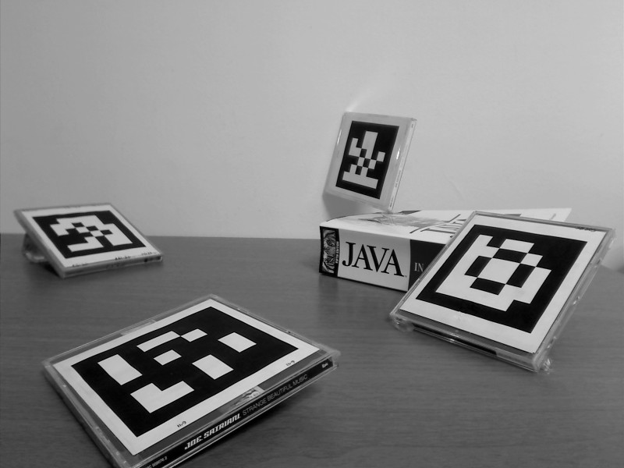
An Introduction to marker-based Augmented Reality…
Dimitris Tzionas

Slide 2
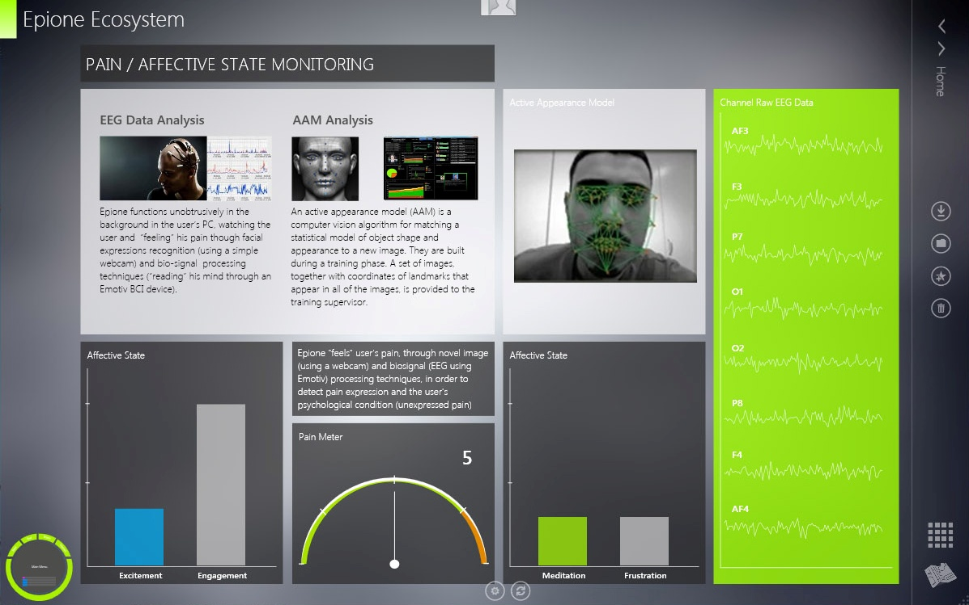
…and holistic Pain Management

Slide 3
Augmented Reality

Slide 6
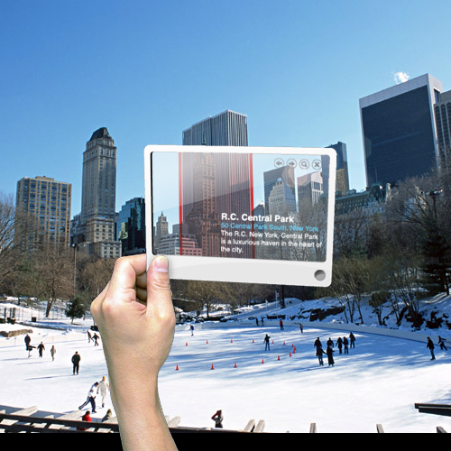

Slide 7
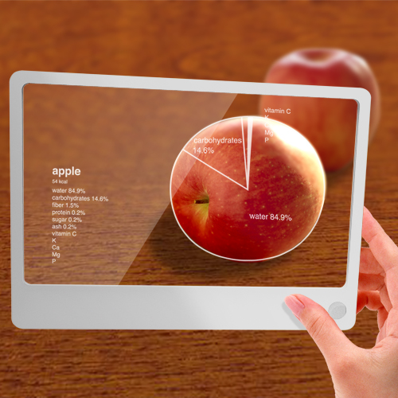

Slide 8
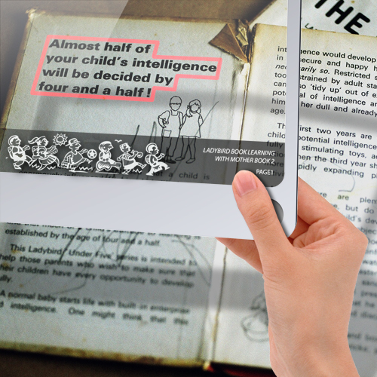

Slide 10
Manufacturing/Repair
Medicine
Entertainment
Culture
Collaborative Apps
Education
TV Broadcasts/Sports
Marketing
Navigation

Slide 11
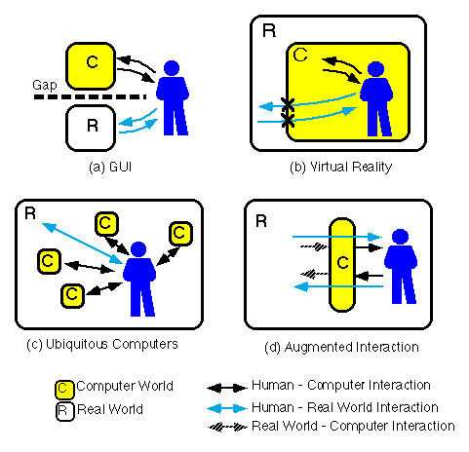

Slide 12
Where?

Slide 13
Visual Tracking

Slide 14
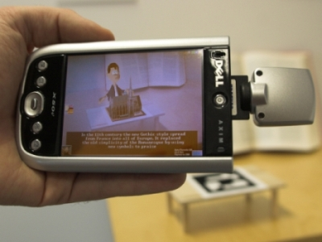
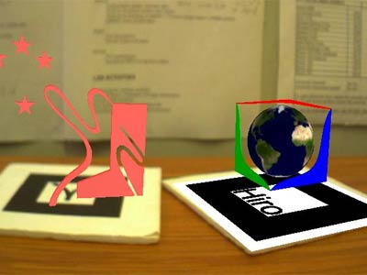
Visual Tracking
“Visual Bits”
“Printed Bits”

Slide 15
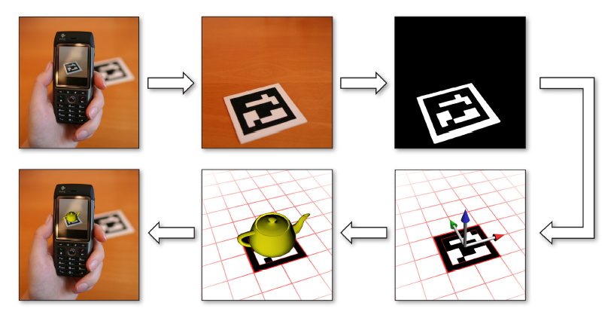
Overview

Slide 16
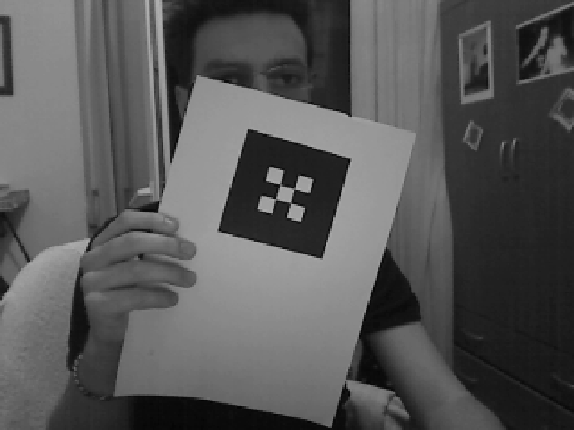

Slide 17
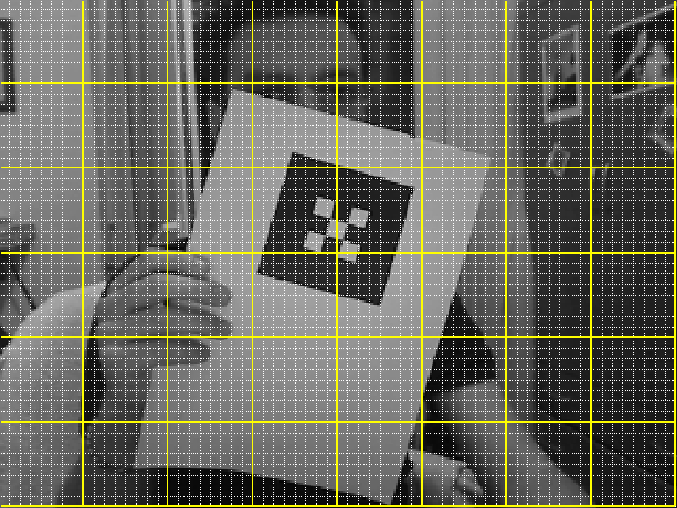
Scanlines
Independent Regions

Slide 18
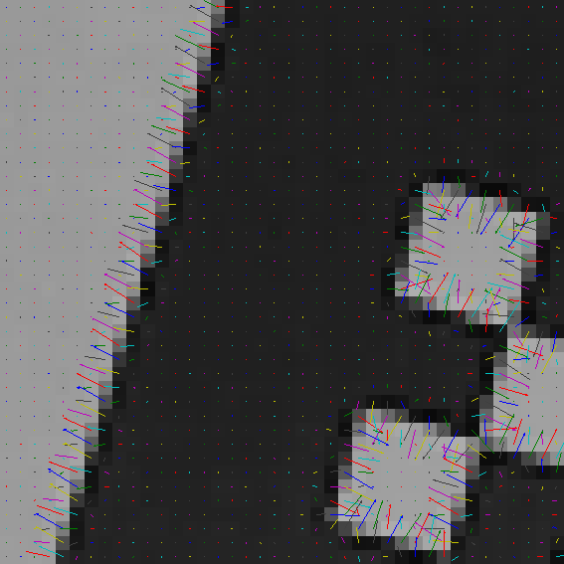
Intensity Gradient
dense scanlines

Slide 19
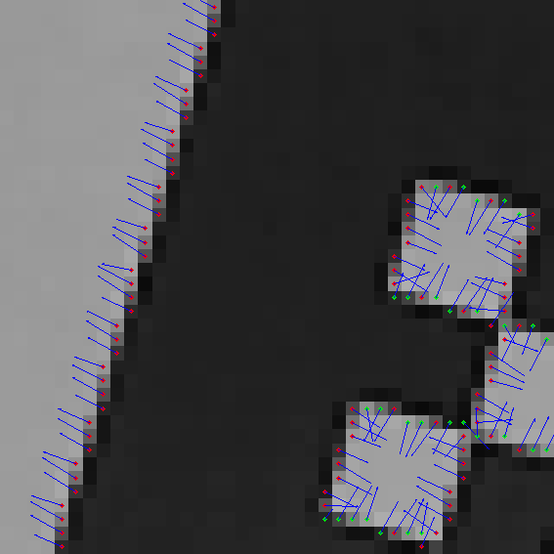
Edgels
pixels on the edge

Slide 20
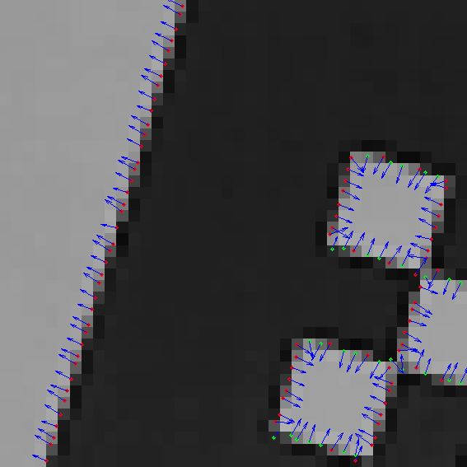
Edgels
(sub-pixel)

Slide 21
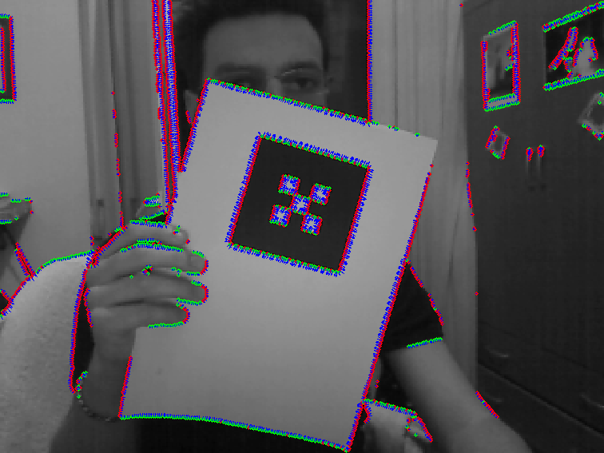
Edgels
dense scanlines
low thresh

Slide 22
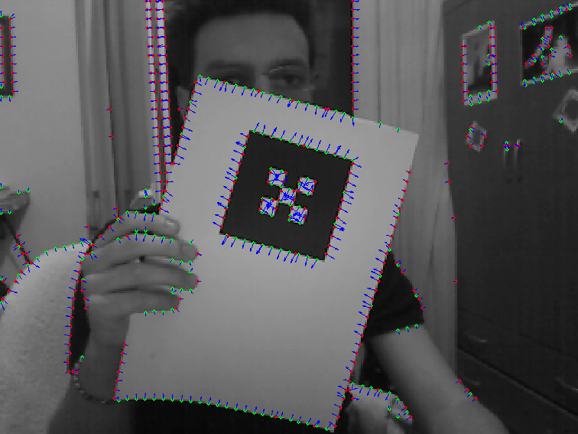
Edgels
sparse scanlines
low thresh

Slide 23
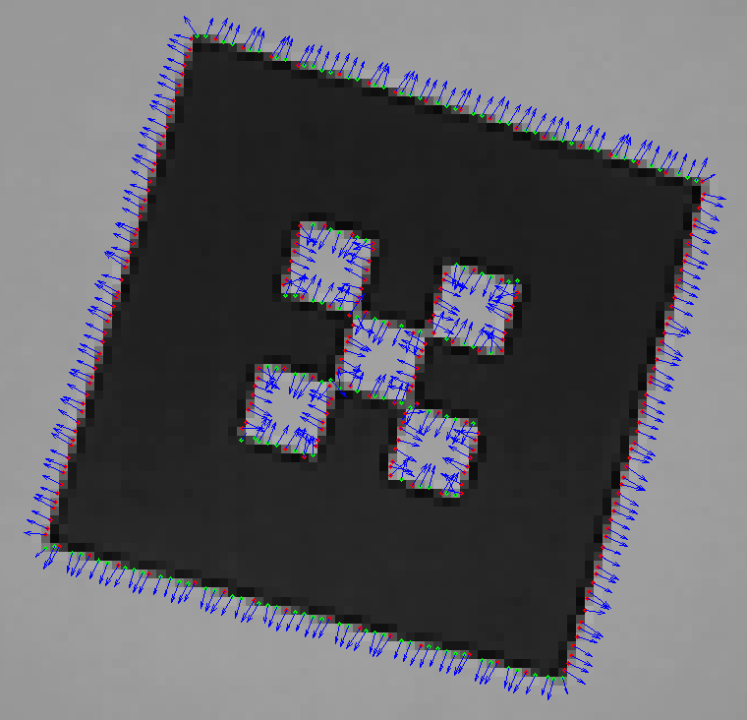
Edgels
dense scanlines

Slide 24
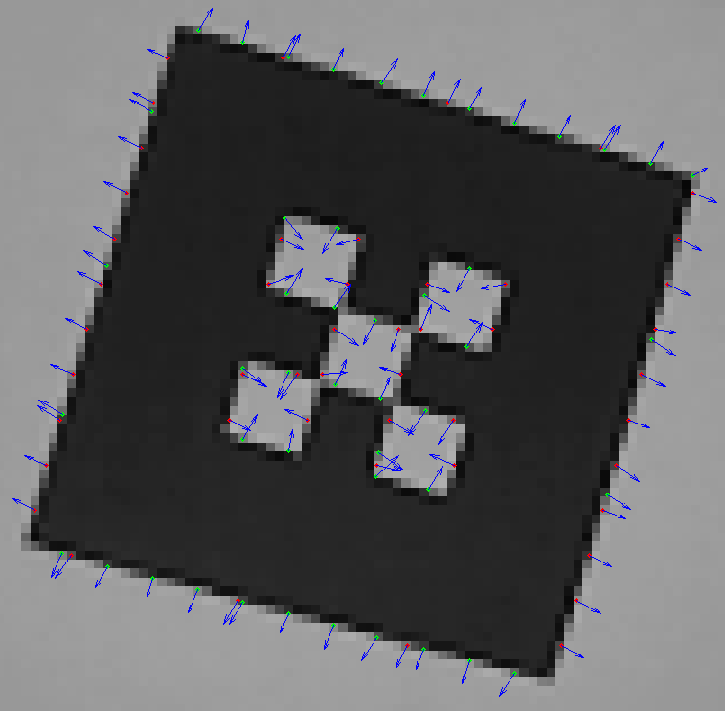
Edgels
sparse scanlines

Slide 25
Edgels
low thresh
dense scanlines

Slide 26
Edgels
medium thresh
dense scanlines

Slide 27
Edgels
high thresh
dense scanlines

Slide 28
dense scanlines
outliers
inliers

Slide 29
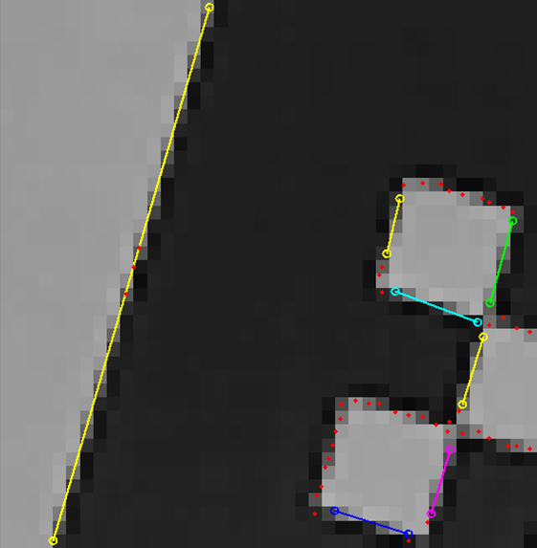
dense scanlines
outliers
inliers

Slide 30
sparse scanlines
outliers
inliers

Slide 31
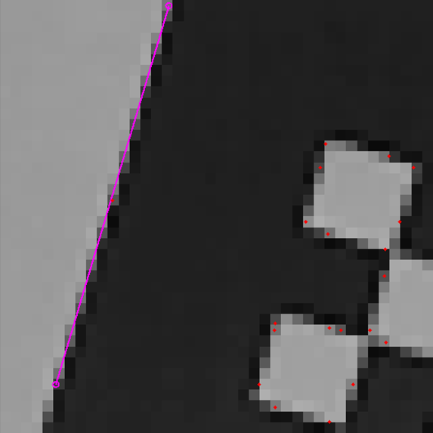
sparse scanlines
outliers
inliers

Slide 32
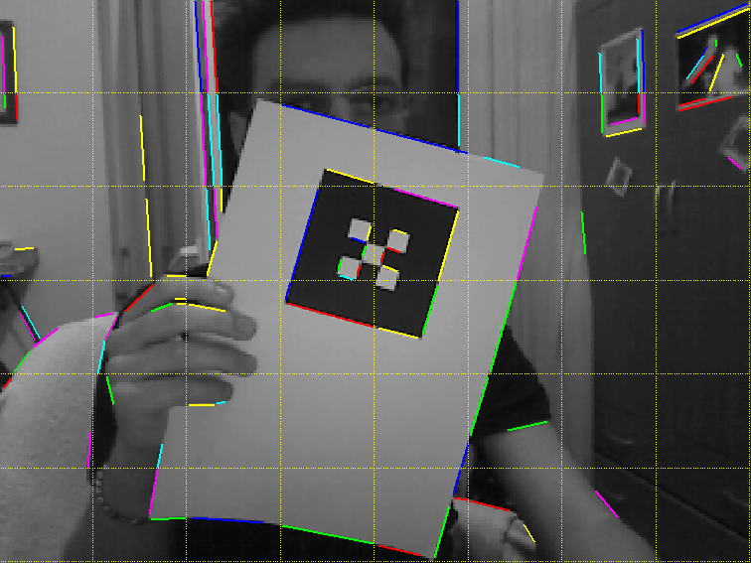
Connecting the Regions
low thresh

Slide 33
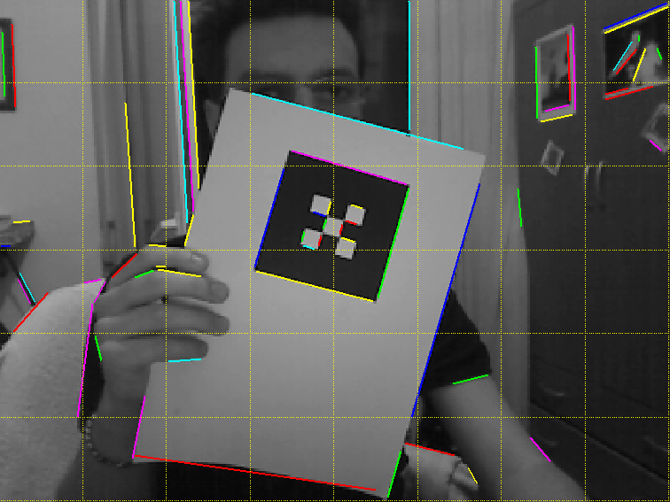
Connecting the Lines
low thresh

Slide 34
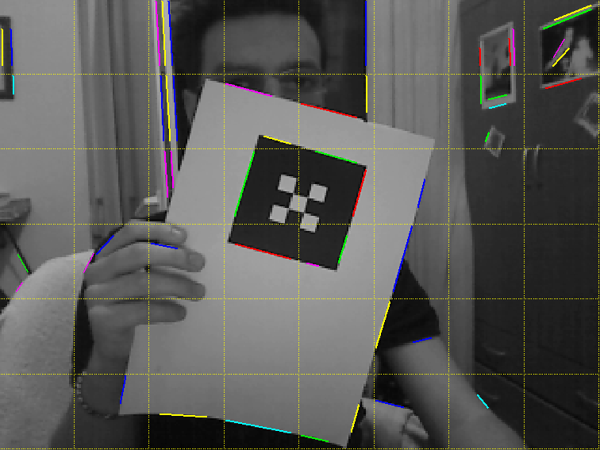
Connecting the Regions
high thresh

Slide 35
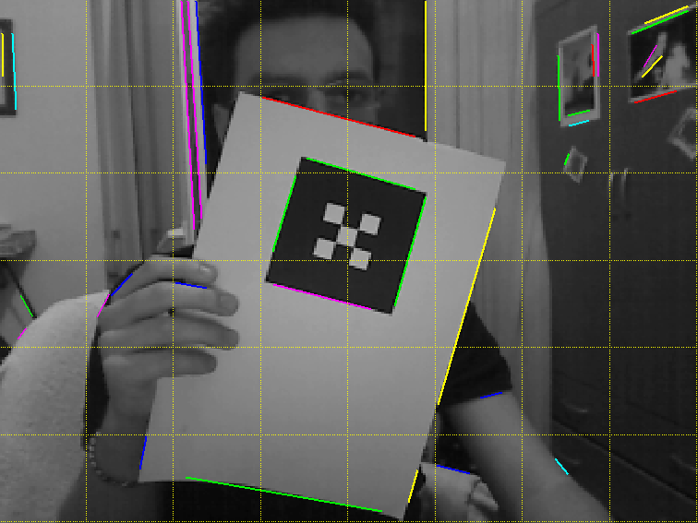
Connecting the Lines
high thresh

Slide 36
Lengthening the Lines

Slide 37
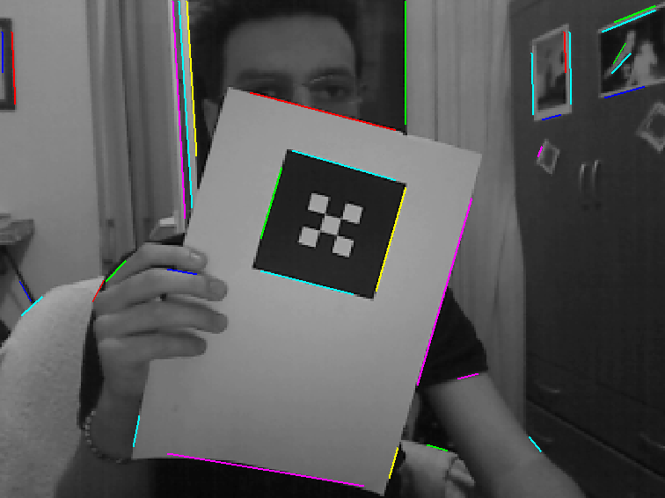
Lengthening the Lines

Slide 38
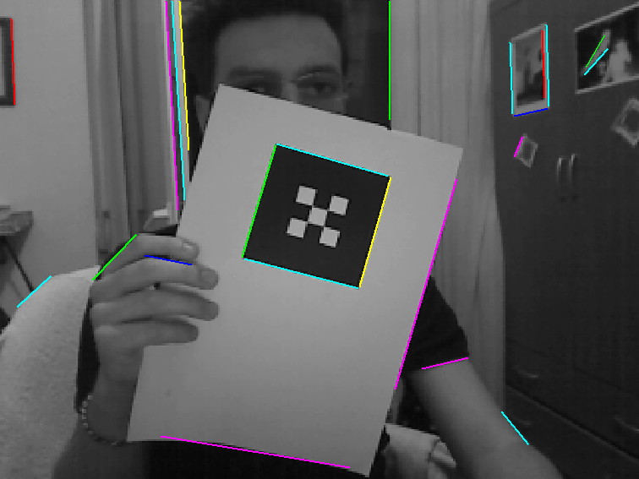
Lengthening the Lines

Slide 39
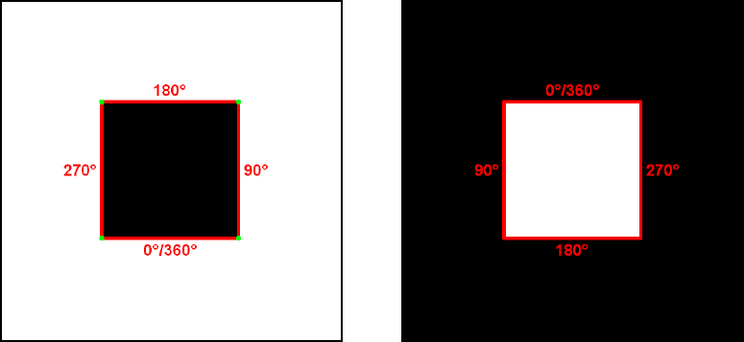
Line “direction”
slope of each line
intensity gradient of edgels

Slide 40
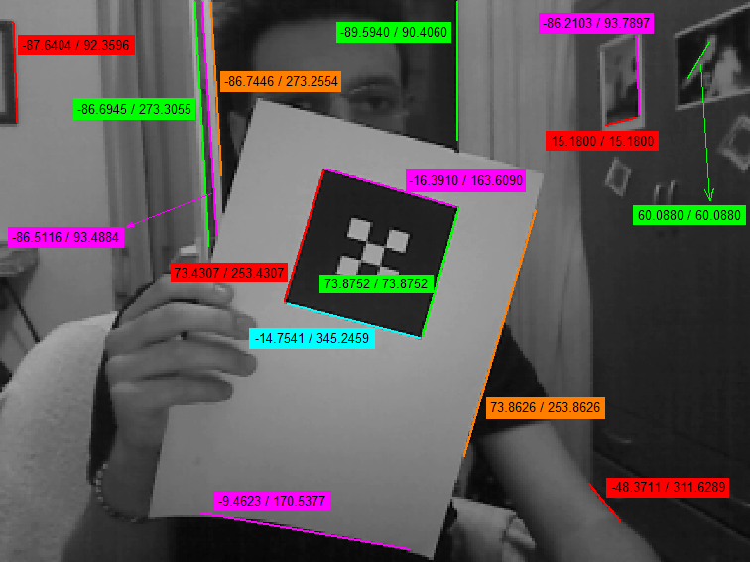

Slide 41
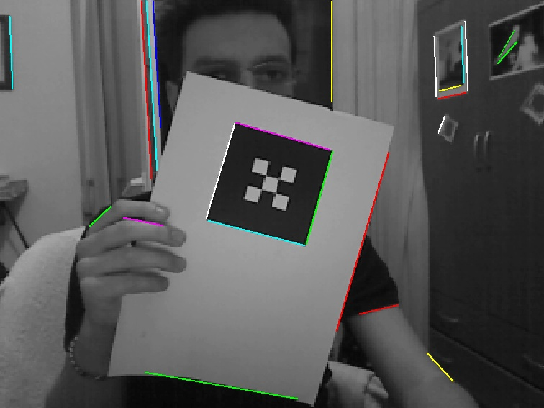
Marker frame detection

Slide 42
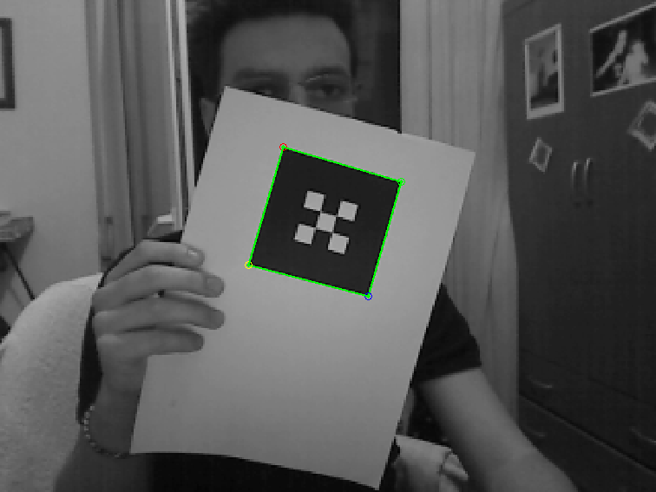
Marker frame detection

Slide 43
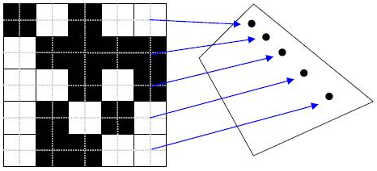
Marker ID scanning
Projective mapping

Slide 44
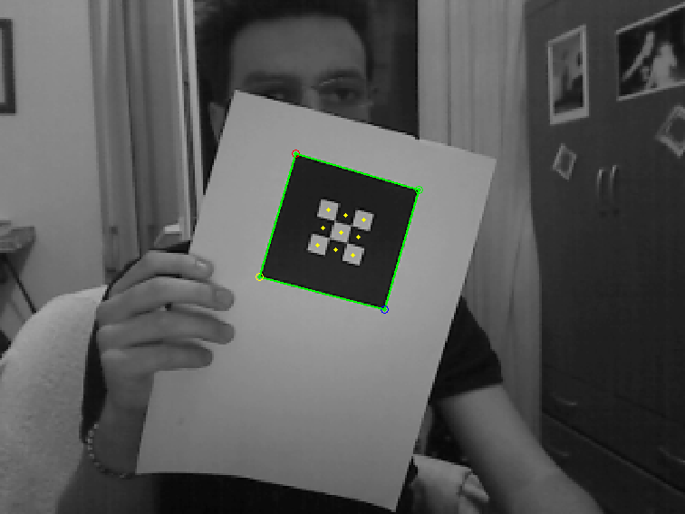
Marker ID sampling

Slide 45
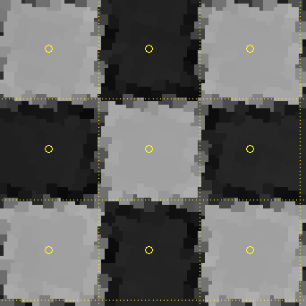
Sampling

Slide 46
Sampled ID

Slide 47
“Printed Bits”

Slide 48
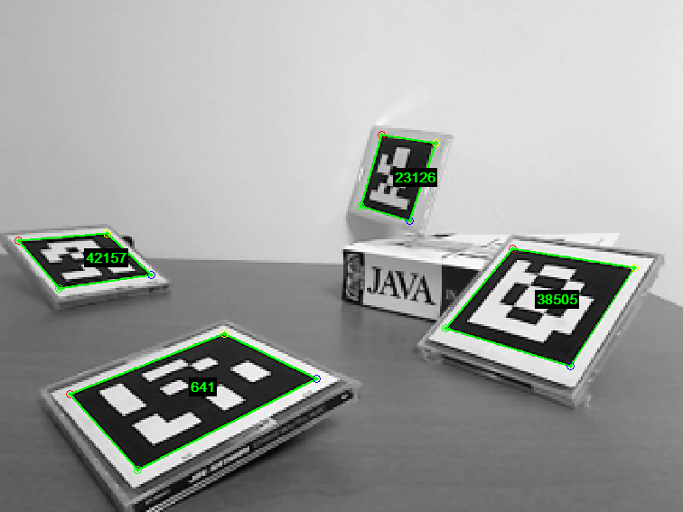
Marker IDs

Slide 49
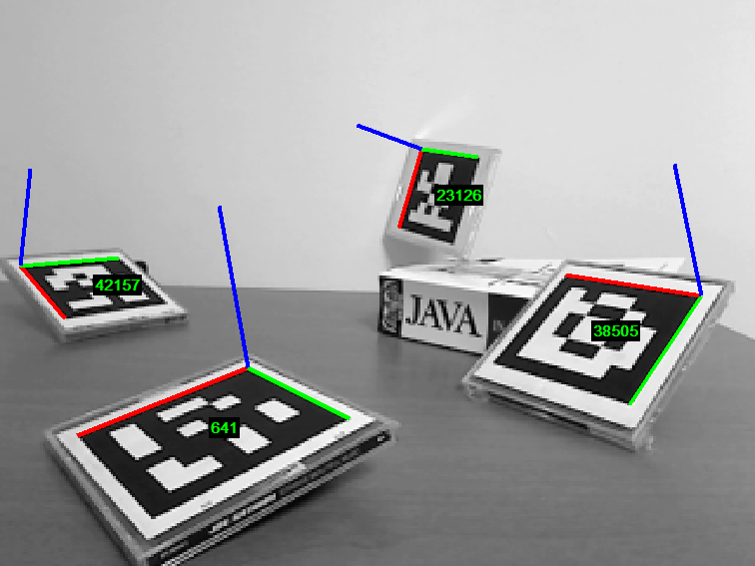
Pose Estimation

Slide 50
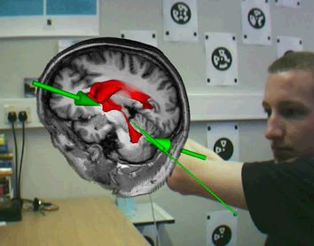
Medical Visualization

Slide 51
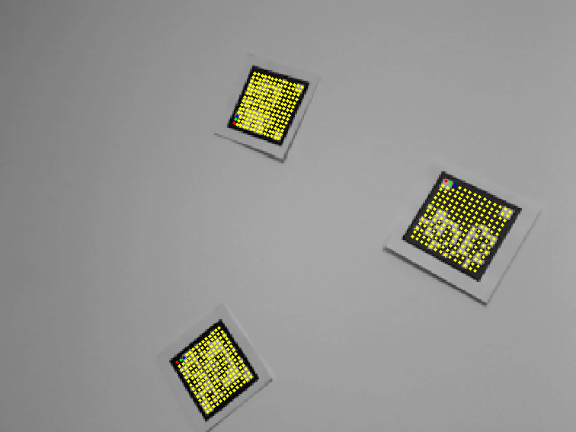
Data markers

Slide 52
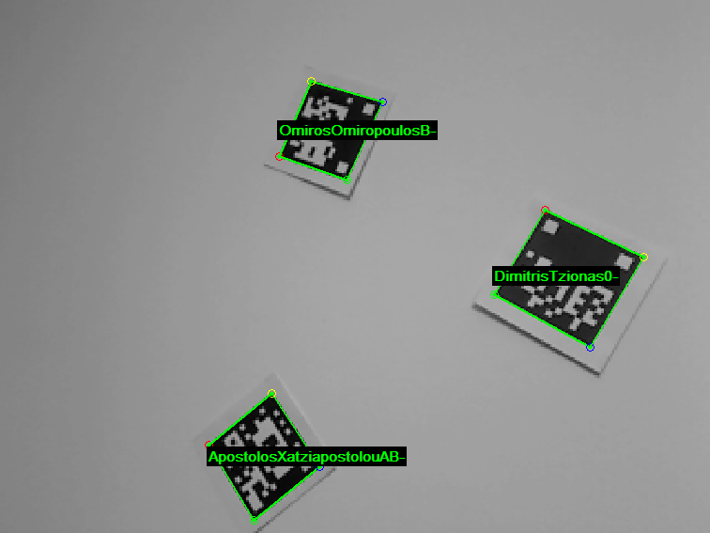
Data markers

Slide 53
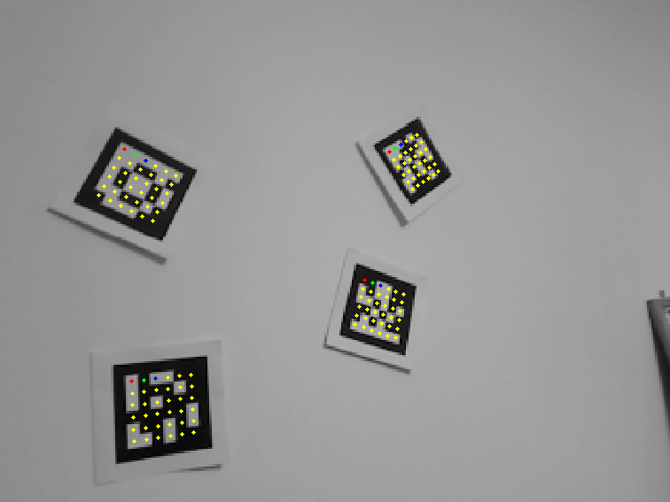
ID markers

Slide 54
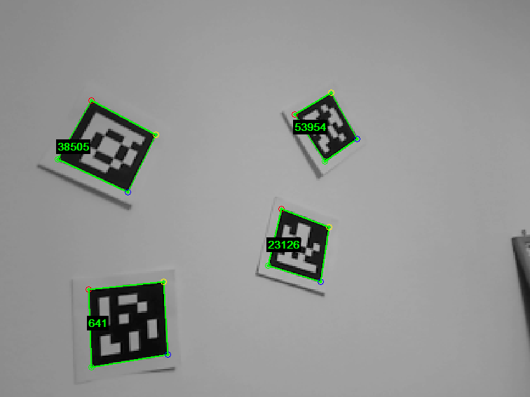
ID markers

Slide 55
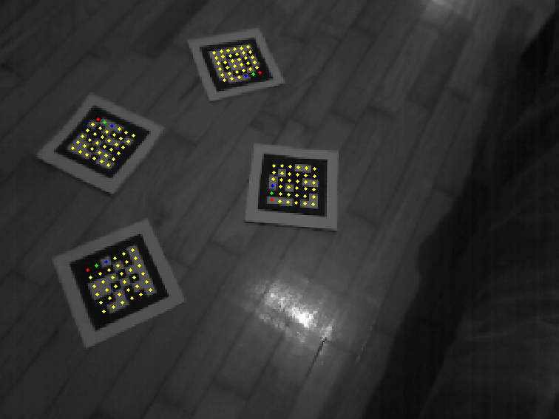
Harsh Conditions

Slide 56
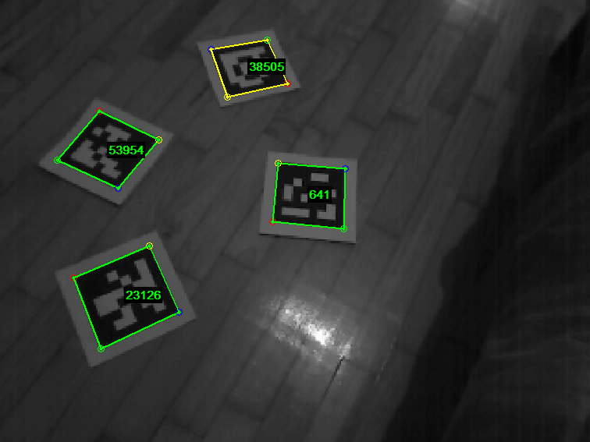
Harsh Conditions

Slide 57
…An introduction to holistic Pain Management…

Slide 58
Thank you
☺

Slide 59
Thank you
☺

Slide 60
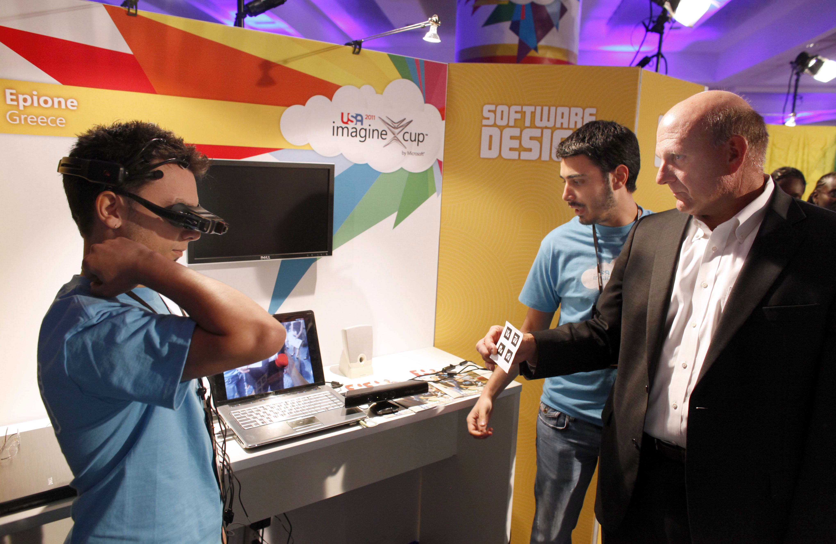

Slide 62
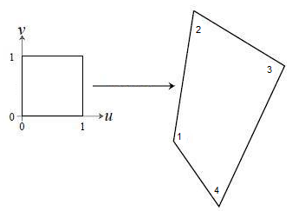
Marker ID scanning
warping

Slide 63
ARToolkit
ARToolkit+
ARTag

Slide 64
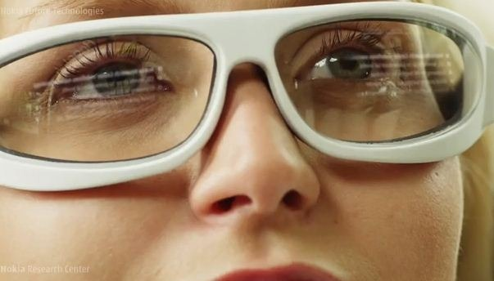
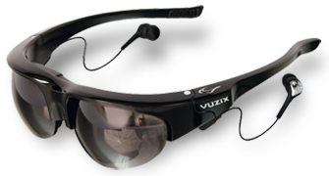
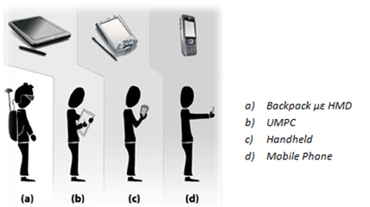
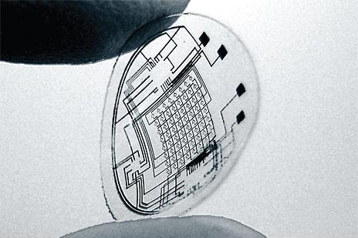

Slide 66
